Slide 1
PREDICTING THE CUSTOMER CHURN
AGENDA
Target audience: technical team
INTRODUCTION & PROBLEM IDENTIFICATION
DATA WRANGLING
EXPLORATORY DATA ANALYSIS
PREPROCESSING & TRAINING DATA DEVELOPMENT
MODELING
USING MODELING & RECOMMENDATIONS
CONCLUSIONS
PRESENTED BY
SANJAY KUMAR MAHTO STUDENT(SPRINGBOARD)

Slide 2
INTRODUCTION & PROBLEM IDENTIFICATION
Customer churn: Situation when customers stop using the services of a company / leave that company.
Reasons:
Other companies offering better services
Bad customer experience
No longer required etc.
Impact : loss of revenue, bad ratings, No growth etc
By being aware and monitoring the churn rate , companies can determine customer retention rate and identify strategies for improvement and providing better services

Slide 3
DATA WRANGLING
The dataset IBM telcom dataset https://www.kaggle.com/blastchar/telco-customer-churn/download
It has 7043 entries , all the columns has many features and a column called churn that state if the customer has churned or not.
Important ones for this project here are: CustomerId, gender,dependentss, contract, PaymentMethod, Monthlycharges,TotalCharges,Churn etc.
Import the dataset to notebook :
Telco_customer_data.info() gives the detailed info about every column

Slide 4
EXPLORATORY DATA ANALYSIS
EDA: Process of performing initial initial investigations on data set to discover patterns, spot anomalies, test hypothesis and check assumptions by summary statistics and graphical representations.
Python library -pandas_profiling is used to generate the visuzalization and understanding of the distribution of each variable. It generates a report with all the information . It tells us the variables that contain NaN values, variables with many zeros, categorical variables with high cardinality, etc.
Seaborn and matplotlib libraries are also used to explore the dataset

Slide 5
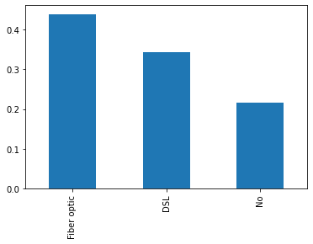
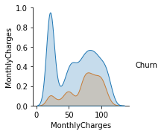
EXPLORATORY DATA ANALYSIS
Customer vs Internet services MonthlyCharges & Churn rate over a month
More can be found on notebook

Slide 6
PREPROCESSING & TRAINING DATA DEVELOPMENT
Here objective: Preprocess data like dropping irrelevant data,dealing with missing values , data types checks etc.
In the dataset, No missing values are found
Use get_dummies() for converting categorical data into dummy or indicator variables

Slide 7
PREPROCESSING & TRAINING DATA DEVELOPMENT
Splitting the dataset :First model needs to be trained, then it has be tested against test data
Using scikit-learn library
we can use LabelEncoder to transform categorical values to numeric value
X : Indepent variable(telco_df.drop(‘Churn’,axis=1)
Y: dependent variable (telco_df[‘churn’]
Now split into train & test data
Sklearn.model_selection and using train_test_split
X_train,X_test,y_train,y_test = train_test_split(X,y,test_size=0.3,random_state=20)

Slide 8
MODELING
We can use different models to predict the target variable
Some are Logistic Regression, Kneighbours,support vector machines,decision Trees, Random Forest etc
Using scikit learn inbuilt modeling we can implement the models
Code snippet :
from sklearn.linear_model import LogisticRegression
from sklearn.neighbours import KNeighborsClassifier
from sklearn.svm import SVC
Similary we can implement use other alorithms

Slide 9
MODELING
For logistic regression
lm = LogisticRegression()
lm.fit(X_train,y_train)
Y_pred=lm.predict(X_test)
Accuracy =lm.score(X_test,y_test)
print(accuracy)
We obtained 81% score which is better than other models after performing the modeling on different models.
We can take logistic regression to predict the target variable

Slide 10
USING MODELING & RECOMMENDATIONS
1.Features such as tenure_group, Contract, PaperlessBilling, MonthlyCharges and InternetService appear to play a role in customer churn.
2. There does not seem to be a relationship between gender and churn.
3. Customers in a month-to-month contract, with PaperlessBilling and are within 12 months tenure, are more likely to churn; On the other hand, customers with one or two year contract, with longer than 12 months tenure, that are not using PaperlessBilling, are less likely to churn.

